Slide 1
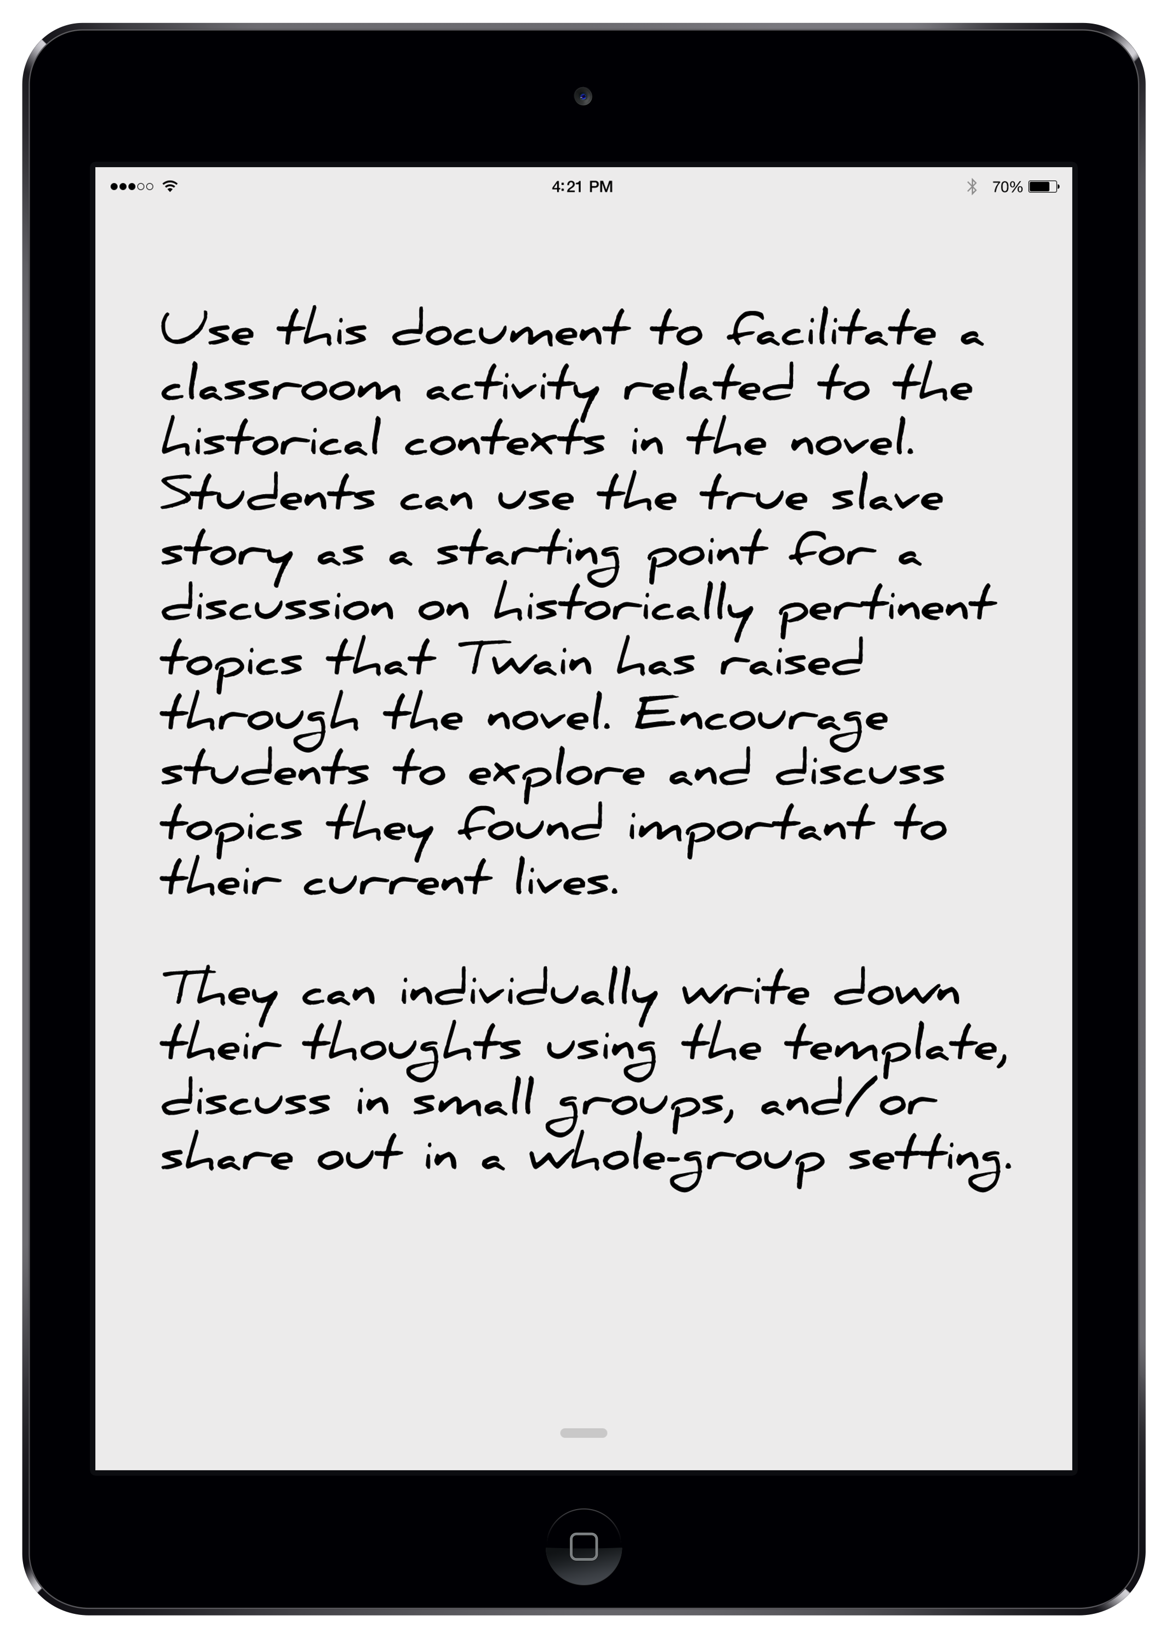
Purpose: To give your students an opportunity to hear a true slave story and explore the historical contexts of the novel

Slide 3
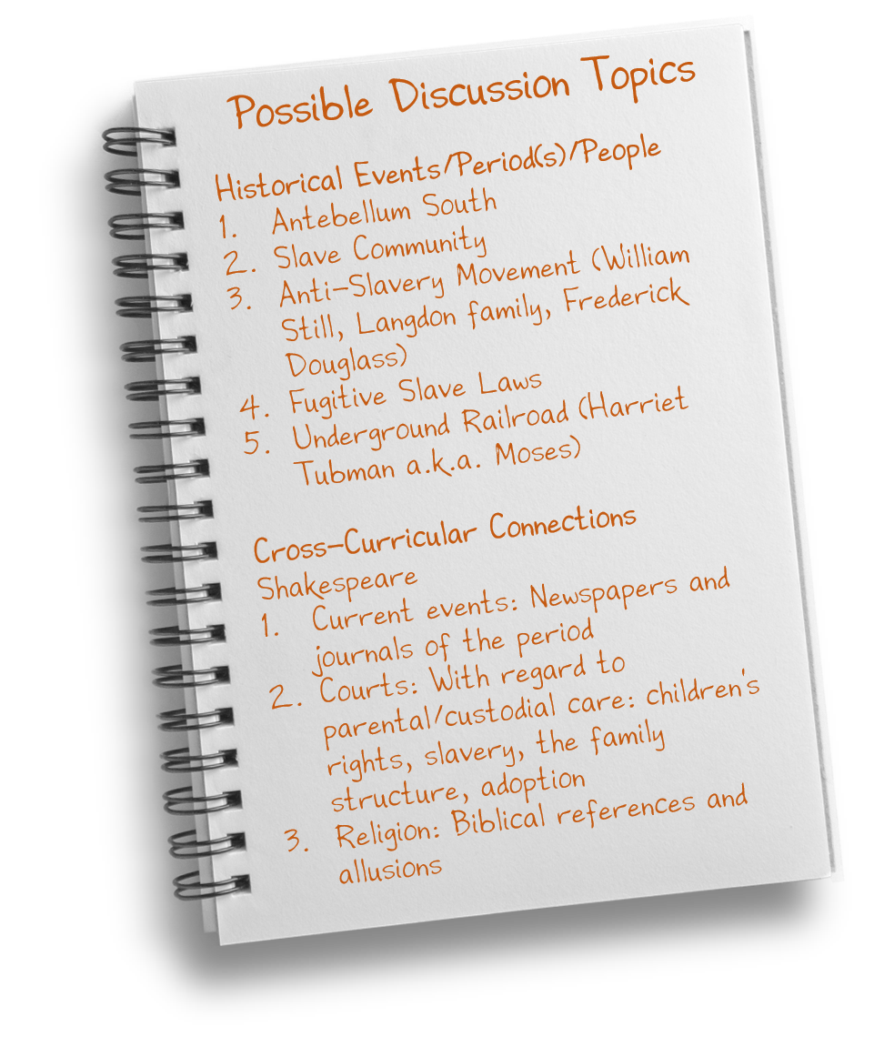

Slide 4
Discussion Template for Students
Historical Topic
Nineteenth-Century Use in the Novel
Twentieth-Century Context

